Slide 1
Steganography: Hiding Information in Digital Media
Group Members:
Shima Vosoogh Rafia Riana Gulpari Alandarova

Slide 2
What is Steganography?
Steganography is the art and science of hiding secret information inside another file, such as:
Images
Text files
Audio files
Video files
The goal is to make the hidden information invisible to unauthorized users.

Slide 3
Types of Steganography
Text Steganography
Hiding information inside text documents.
Image Steganography
Hiding information inside digital images.
Audio Steganography
Hiding information inside audio files.
Video Steganography
Hiding information inside videos.

Slide 4
Introduction to Image Steganography
Image steganography is a technique used to hide secret information inside digital images without noticeably changing their appearance.
The hidden information may include text messages, passwords, documents, or other data.
Because the modifications are very small, the image appears unchanged to the human eye.
Why use images?
Images are widely shared online.
They contain millions of pixels.
Small changes are difficult to detect.
They can store a significant amount of hidden information.

Slide 5
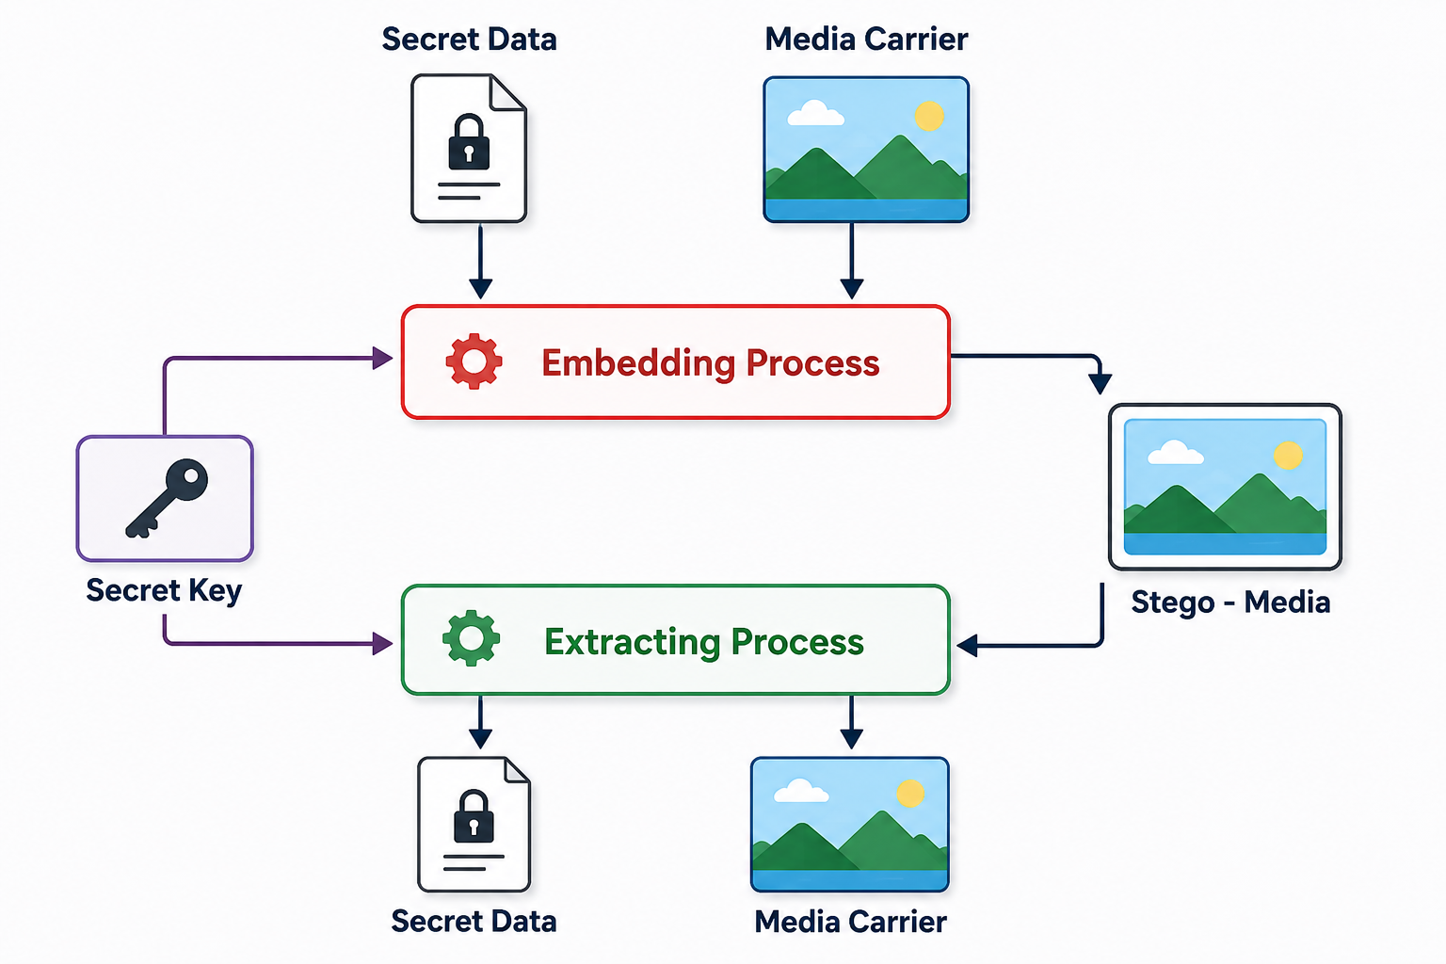
How Image Steganography Works
Select a cover image.
Prepare the secret message.
Convert the message into binary format.
Embed the data into image pixels.
Generate a stego image.
Extract the hidden information when needed.

